Slide 1

Design and Simulation of an 8-Bit Arithmetic Logic Unit (ALU)

Slide 2
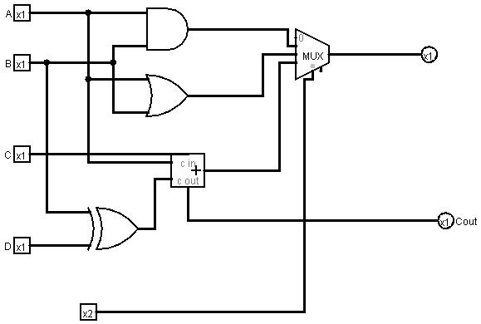
8 BIT ALU CIRCUIT DIAGRAM

Slide 3

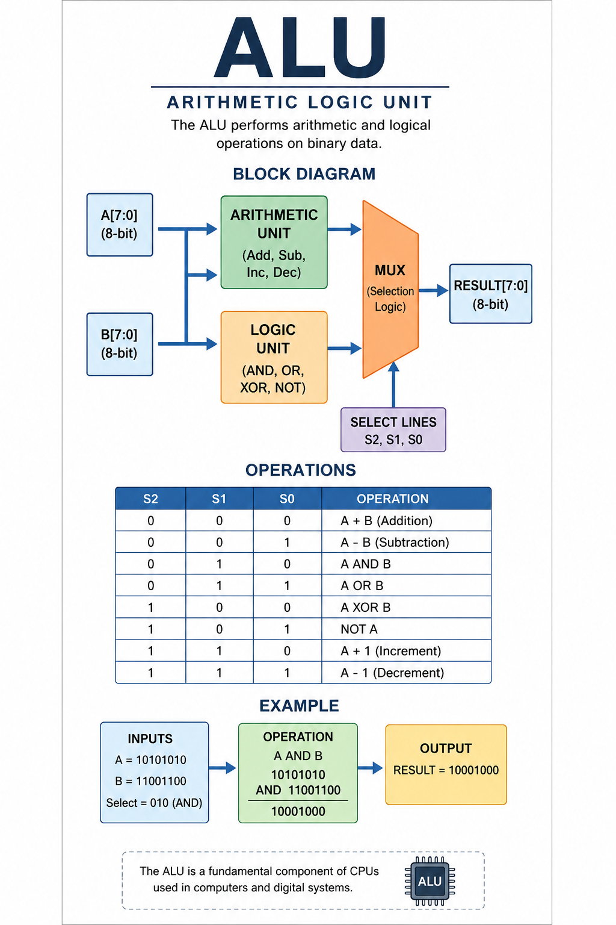

WHAT IS ALU?
An Arithmetic Logic Unit (ALU) is the main computational component of a processor. It performs arithmetic and logical operations on binary data. In this project, an 8-bit ALU is designed and simulated using digital logic circuits.
ALU
Operations Supported
  ALU stands for Arithmetic Logic Unit.
  It is the computational part of a CPU.
  Performs arithmetic and logical operations on binary data.
  Used in processors, calculators, and embedded systems.
Addition
Subtraction
AND
OR
XOR
NOT

Slide 4
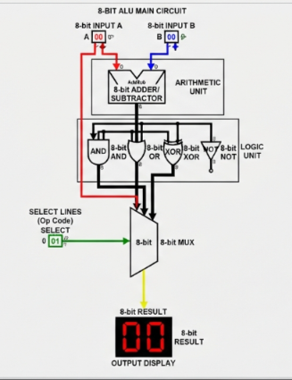
Components Used :
Working:
  8-bit Inputs (A and B)
  Adder/Subtractor Circuit
  Logic Gates (AND, OR, XOR, NOT)
  Multiplexer
  Output Display
  Inputs A and B are given.
  Select lines choose the operation.
  Multiplexer sends the selected result to the output.

Slide 5

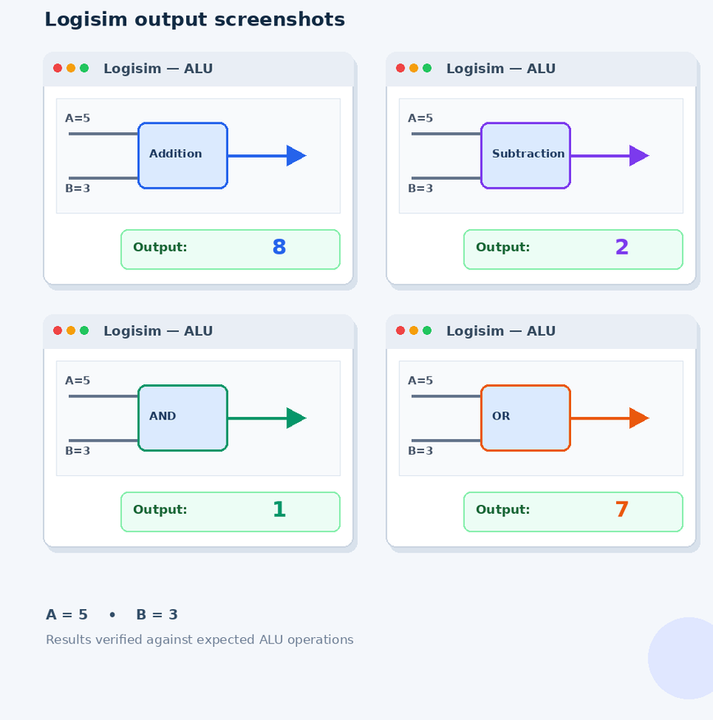
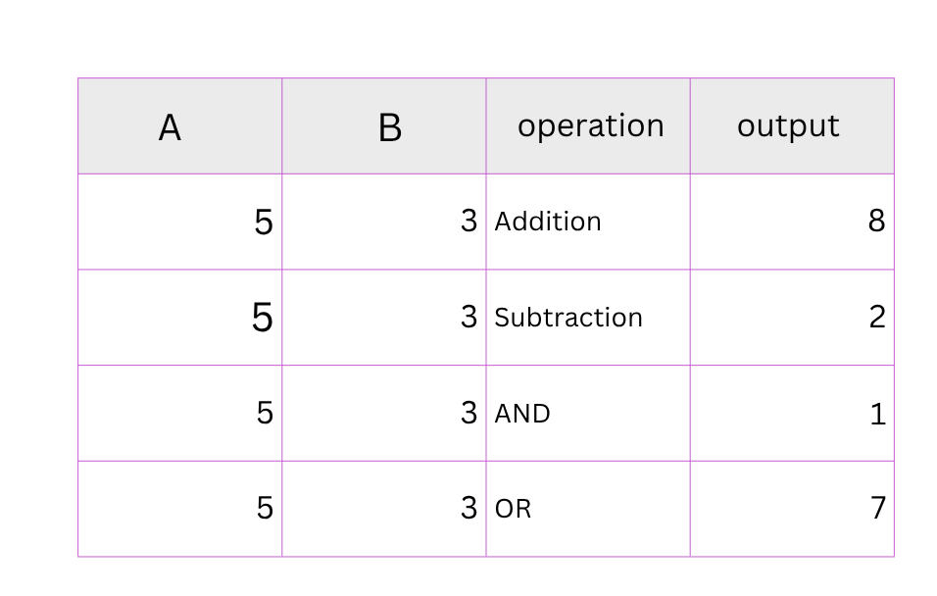
Simulation Results

Slide 6
Application of ALU
  CPUs and Microprocessors
  Digital Computers
  Mobile Phones
  Calculators
  Embedded Systems

Slide 7
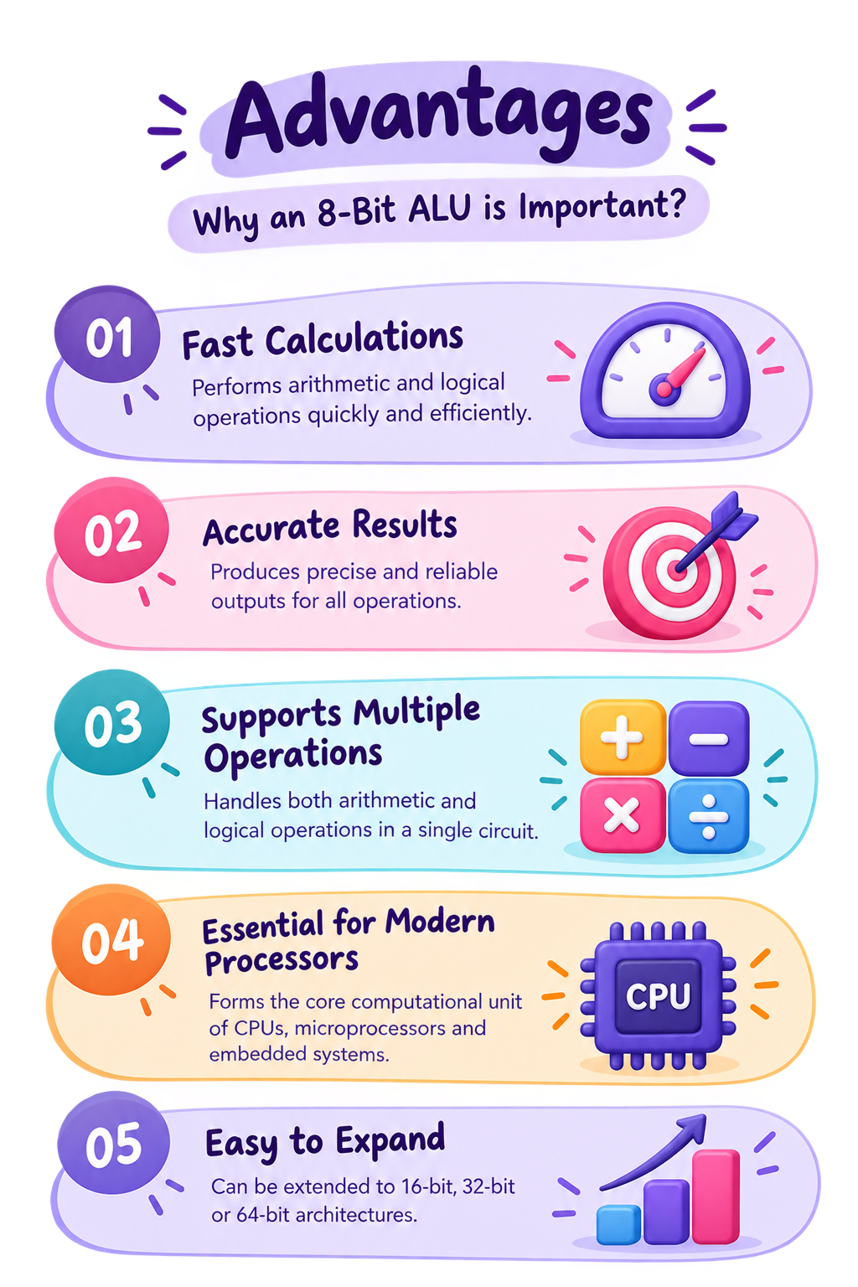
Advantages:
  Fast calculations
  Accurate results
  Supports multiple operations in one circuit
  Reduces manual calculations.
  Essential component of modern processors.
  Easy to expand to 16-bit, 32-bit, or 64-bit systems.

Slide 8
Conclusion
1
2
3
Successfully designed and simulated an 8-bit ALU using Logisim
Performed arithmetic and logical operations correctly.
Understood the role of ALUs in computer architecture.

Slide 9
Thank You
BY 2620080015 -TAHSEEN UNNISA 2620080048- GALIDEVARA BHAVYA SREE LAASYA
2620080070 -SARIPELLI ABHIJNA SRI 2620080083 -MARELLA SRINIKA VAISHNAVI

